Slide 1


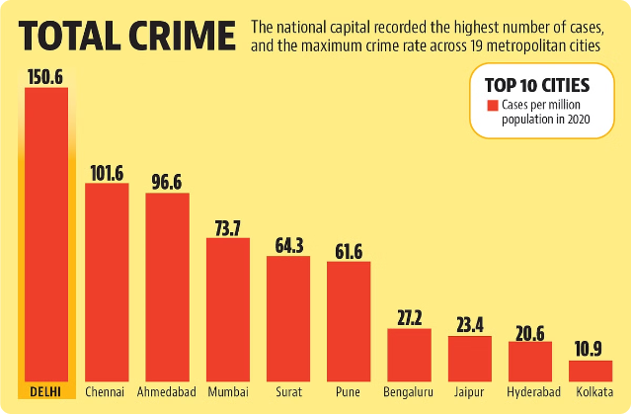
Analysis of Crime Data in India (2019-2021)
This presentation analyzes crime data from India covering the years 2019-2021. The analysis focuses on trends, patterns, and insights related to various crimes.
by Ramesh Aravindh
RA

Slide 2
Introduction
Objective
Datasets
This study aims to analyze crime data across India from 2019 to 2021 to identify key trends, patterns, and insights related to various crimes.
Crime Against Children
Crime Against Women
IPC Crimes (State and City-wise)
Murder Cases and Victims (Gender and Age Group-wise)
Total Complaints Received

Slide 3

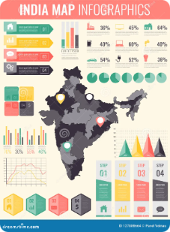
Data Overview
Description
Structure
The datasets cover various crime categories from 2019 to 2021. They include state-wise and city-wise data for detailed analysis, focusing on crimes like murder, kidnapping, and violent crimes.
Each dataset contains columns for states, cities, crime types, and years. The data is cleaned, formatted, and standardized for comparison.

Slide 4

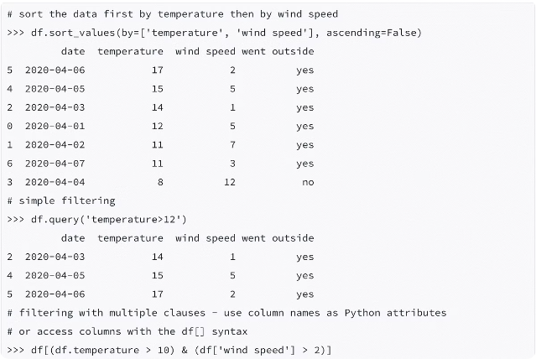
Methodology
1
Tools
Python libraries like Pandas, NumPy, and Matplotlib were used for data analysis. Excel was used for initial data inspection.
2
Approach
The analysis involved data cleaning to address missing values and inconsistencies. Exploratory Data Analysis (EDA) used statistical methods and visualizations. Comparative analysis compared crime statistics across years, states, and crime categories.

Slide 5

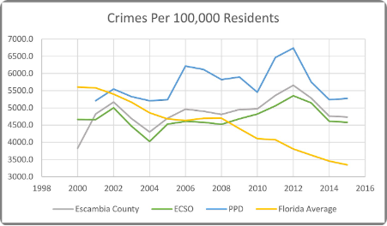
Key Findings
Crime Trends (2019-2021)
Overall crime rates increased by X% from 2019 to 2021. Uttar Pradesh consistently had the highest crime rates across multiple categories.
Crimes Against Women and Children
Significant increase in crimes against women, particularly in Maharashtra. Children, especially below 18, were highly affected in states like West Bengal.
Murder and Victim Demographics (2021)
Uttar Pradesh had the highest murder cases. Most murder victims were male, aged 30-45.5.

Slide 6




Challenges and Limitations
Data Inconsistencies
Some datasets had missing values, requiring careful handling. There were also inconsistencies in reporting across regions.
Regional Bias
Potential bias due to uneven reporting standards between states and cities could have influenced the results.

Slide 7




Conclusion and Future Work
Conclusion
Crime trends reveal significant regional disparities. Targeted interventions are necessary in crime hotspots and vulnerable demographics.
Future Work
Further analysis at a more granular level (e.g., district-wise) is recommended. Predictive modeling could be used to forecast future crime trends.

